Slide 1
Multimedia Systems
Dr Laura Toni
l.toni@ucl.ac.uk
University College London

Slide 2
Today Lecture
Introduction to Information compression
Source Coding
Information and Entropy
Variable length coding
Quantization
Multimedia Systems
Image and Lossy Compression
Transforms
JPEG Quantization
JPEG Lossless Compression
Video Compression
Motion Compensation

Slide 3
Block Diagram for Image Compression
Signal Decomposition:
Compact energy into a small number of coefficients
Decorrelate the components of the signal
Quantization:
Make approximations to the transform coefficients
Selectively throw away information
Lossless coding
Variable length coding (e.g., Huffman Coding)
Choose short/long codewords to minimize number of bits

Slide 4
Transform Coding
x
u
u
x
A
A⁻¹
We are interested in transforming a signal or image from the spatial domain to the frequency domain
by itself, the transform – does not save any bits – does not introduce any distortion
both of these happen when we throw away information - “lossy compression” implemented by the quantizer

Slide 5

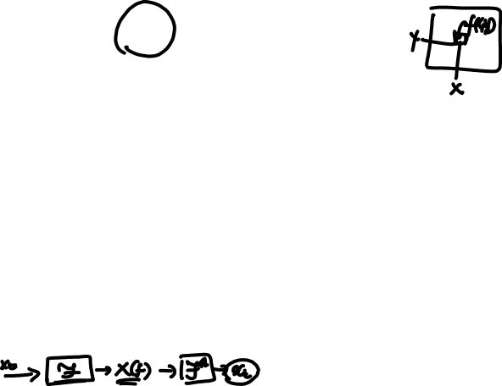
2-d DCT Basis Functions
The whole array of
basis functions looks
like this:
The array of DCT
coefficients tells how
much of each of these
basis images we need
to regenerate original image
Low frequencies
DC coefficient
High
frequencies

Slide 6
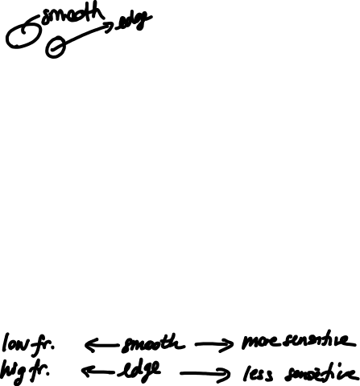
Why is the DCT a good idea?
Smooth areas in the images have pixels highly correlated
Pixels around edges are less correlated
Our visual system is less sensitive to distortion around edges
We want to protect smooth areas the most
DCT has excellent energy compaction for highly correlated data (smooth areas).
Low frequencies in the DCT correspond to smooth areas
We can quantize less heavily low frequencies

Slide 7

Quantization after Transforming
After the DCT, we still have N² numbers to represent a block:
N² pixels ↔ N² coefficients
However, the N² coefficients will have
Lot of values near zero
Lot of values which represent high frequency info

Slide 8
Block Diagram for Image Compression
Signal Decomposition:
Compact energy into a small number of coefficients
Decorrelate the components of the signal
Quantization:
Make approximations to the transform coefficients
Selectively throw away information
Lossless coding
Variable length coding (e.g., Huffman Coding)
Choose short/long codewords to minimize number of bits

Slide 9

Let’s continue the example
DCT
source
DCT
Transformed coordinates
(N² values)
Pixel intensity (N² values)
How can we apply the quantizer?

Slide 10

Let’s continue the example
We consider a quantizer matrix, in which higher frequency are quantized more heavily
Low frequencies
High
frequencies

Slide 11
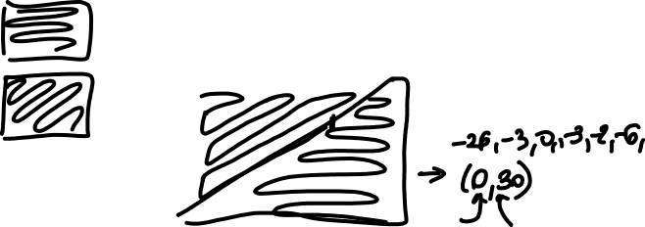
Let’s continue the example
DCT
source
DCT
Q matrix
Quantizer
Quantized DCT

Slide 12
Can we reconstruct the image?
however visually the blocks are not very different
Hence, we highly compressed the image without having “perceptual” losses!

Slide 13
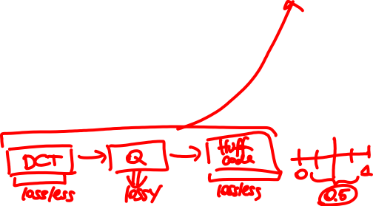
Source Coding
Source Encoding
Lossless
(text, programs)
Lossy
(images, videos)
Run Length Encoding
Huffman Code
Incremental Encoding
Vector Quantization
Transform Coding
Wavelet Compressor
Notes:
Two main coding types are used in Mobile Communications
Speech Coding – source coding
Reduces the redundancy to minimise the bandwidth
Error Coding – Channel Coding Techniques
Increase the redundancy to reduce errors and improve reliability

Slide 14

Take Home Message
Information theory tells us to look at the probability of the source when coding (most probable words, shortest bits)
Quantizer follows the same concept: quantize heavily the least probable ranges
Image compression is composed of
There is redundancy in the images.
Artefacts in high-frequencies (edges) are less noticeable from the human eye
Source transformation (to compact the energy – most high frequency values will be low)
Quantizer (2D quantizer that will cut off high-frequencies)
Zig-zag rastering will maximize the probability of having 0s
Huffman lossless code as last step
Notes:
Two main coding types are used in Mobile Communications
Speech Coding – source coding
Reduces the redundancy to minimise the bandwidth
Error Coding – Channel Coding Techniques
Increase the redundancy to reduce errors and improve reliability

Slide 15
Thank You

